Slide 1
NE 763: Advanced Reactor Materials
Fall 2025
Dr. Benjamin Beeler

Slide 2
Housekeeping
Reminder:
Class eval is up, please fill this out: http://go.ncsu.edu/cesurvey
currently four of you have done it, please all complete this
My survey for +5 on last exam (anonymous, but send me confirmation): LINK
only one confirmation thus far

Slide 3
Last Time
U-Mo interaction layer
U-Mo-Al phases, rich in Al, goes amorphous and can cause excessive swelling
Addition of Si suppresses Al-rich phases, limits IL growth up to moderate burnups
Why monolithic fuel?
removes the matrix and prevents amorphous IL formation (but requires Zr layer)
increases U density, allows for additional Mo to better stabilize gamma U-Mo
Monolithic fabrication
rolling, HIP, annealing: all stages impact microstructure
Zr interdiffusion barrier leads to complex phase environment; failure via bubble interconnection and delamination often occurs at very high burnups near Zr layer
Phase decomposition
should be limited as excess as-fab decomposition leads to earlier grain refinement
Started on Al in RTRs

Slide 4
Radiation Damage in Al
Radiation damage effect are generally lessened in Al alloys because of the high homologous temperature/low melting point (operating around 0.3 Tm)
Thus, vacancies are more mobile, which can increase the amount of recombination that can occur
At high fluences, this can lead to the relatively large loops and voids shown last time
Defect clusters and voids do not form at grain boundaries, which are very strong sinks for interstitials
Impurities and transmutation products are also drawn into the grain boundary, which can lead to bubbles or precipitates
Numerous solutes can reduce radiation damage accumulation via lattice misfit strains

Slide 5
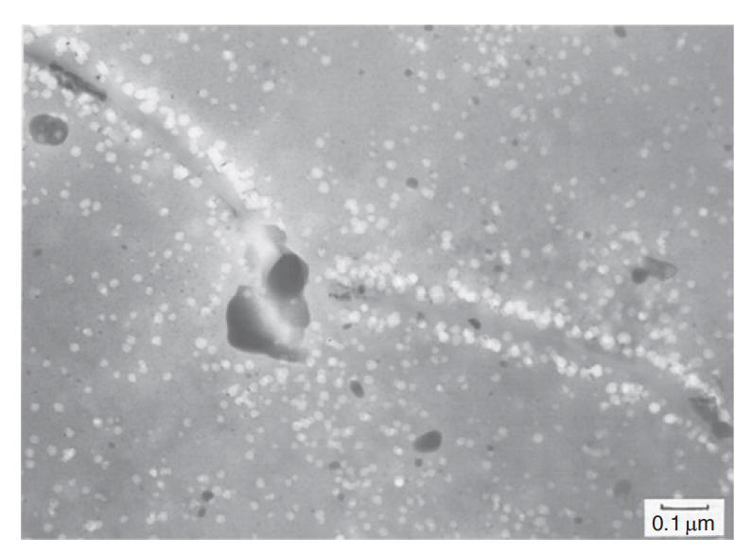
Aluminum GBs
Al develops wide denuded zones around the grain boundaries
Due to the greater mobility of the interstitials and the bias of GBs for absorption of interstitials, the zone deprived of interstitials is wider than that for the vacancies
This creates an unbalanced concentration of vacancies at the rim of the denuded zone, leading vacancy clusters at the rim
At sufficiently high fluences, can have sheets of voids which potentially provide fracture pathways
Also visible in image are Si precipitates (Si present as alloying addition and generated via transmutation)
Fluence of 3.4E26 n/m2

Slide 6
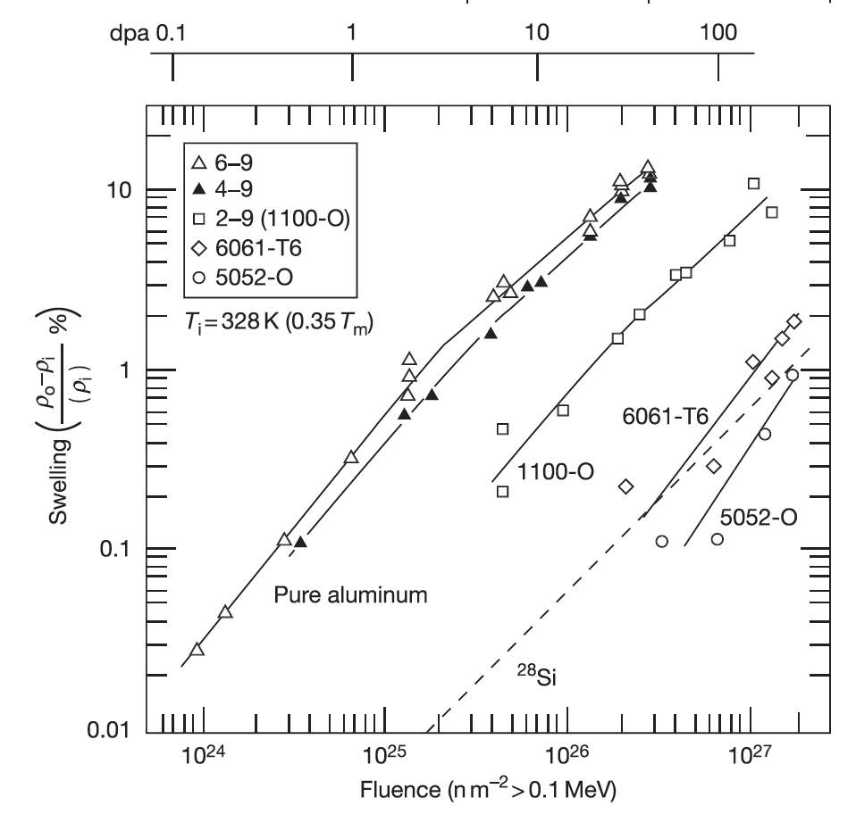
Swelling
Swelling is due to the accumulation of voids from excess vacancies
Gas bubble swelling is generally not an issue for Al in RTRs because the temperature is too low
The 6061 alloy, with its inherent Mg2Si phase, starts swelling appreciatively later in dose than the 1100-O or pure Al
Swelling is limited to less than 1% for the higher levels of fluence expected in RRs

Slide 7
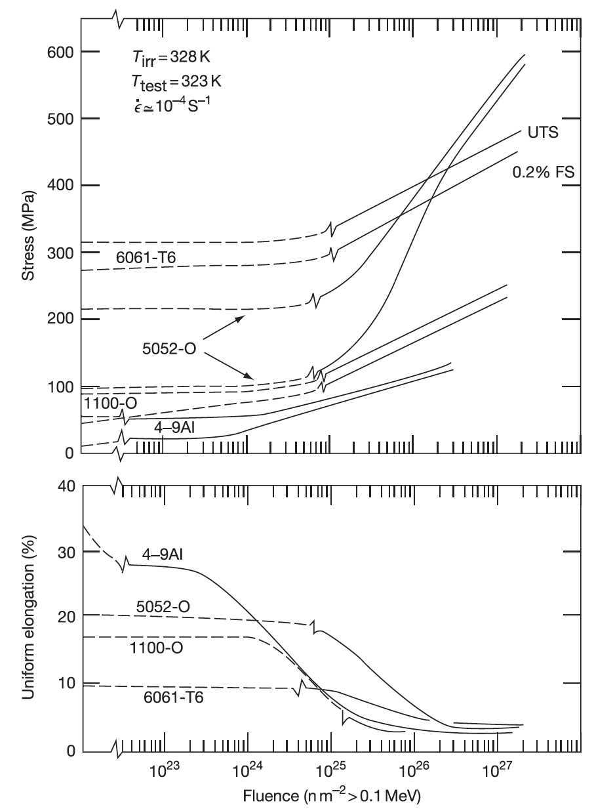
Hardening
The major consequences of radiation damage accumulation on the mechanical properties of Al alloys are radiation hardening and associated loss in ductility
Al6061 is generally a stronger alloy than comparable Al alloys
Hardening and reduction in elongation occur at approximately 1E25 n/m2, with as much as a 2X (1/2X) effect on the associated property

Slide 8
Corrosion
In water, Al it combines with oxygen to form an adhesive, self-healing Al2O3 film that retards further oxidation at the metal surface
HPRRs, the films grown on the fuel cladding may be 20–50 microns thick
The most common corrosion product reported on aluminum cladding is boehmite, a crystalline monohydrated aluminum oxide, Al2O3-H2O
Corrosion is diffusion limited, and thus slows with a growing oxide layer
Oxide layer degrades thermal conductivity of the fuel plate, and thus higher heat fluxes can cause higher rates of corrosion
Spallation can potentially occur in overly thick oxide layers (> than 50 microns)
Plates are often pre-filmed with a boehmite layer to improve corrosion resistance by ensuring you start with a stable, thin oxide layer
Generally, oxidation is relatively slow and predictable, and presents few problems, but must be accounted for

Slide 9
Al Summary
Low melting point, relatively low strength, high thermal conductivity
Easy to fabricate, cheap, well known, very ductile
Al is quite radiation resistant, largely because we are operating at relatively high homologous temperatures (high recombination)
Dislocation loops and voids can form inside grains
Denuded zone appears as interstitials preferentially sink to grains, can lead to void accumulation on rim of denuded one
Al doesn’t show hardening or ductility loss until fluences of ~1E25 n/m2 (much higher than Fe or Zr)
Al exhibits very good corrosion resistance, with the formation of thin, stable Al2O3 layers

Slide 10
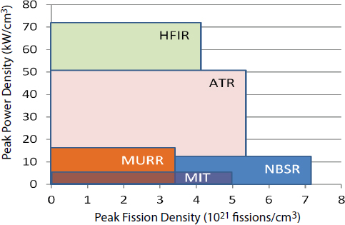
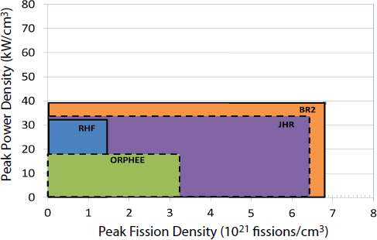
Reactor Operating Range
US-based Reactors to be converted:
ATR and ATR-C
MURR
MITR
NBSR
HFIR?
EU-based reactors to be converted:
BR2 (Belgium)
JHR (France)
RHF (France)
ORPHEE (France, but has shut down)

Slide 11
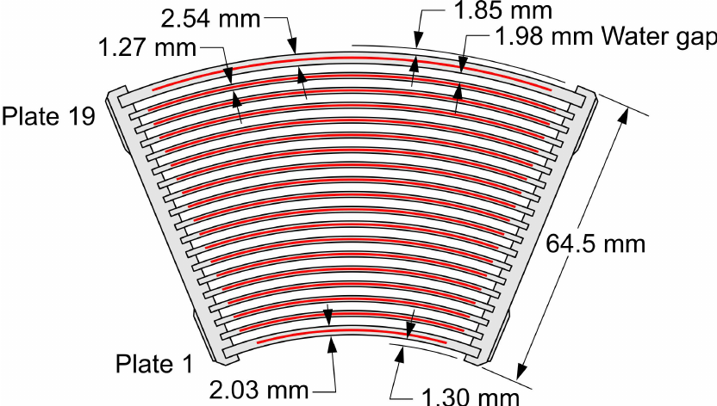
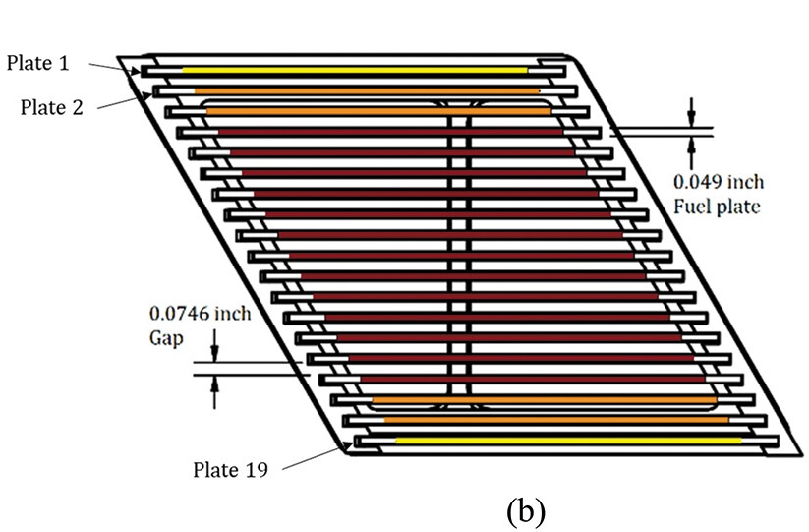
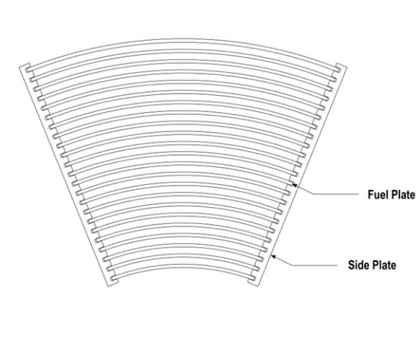
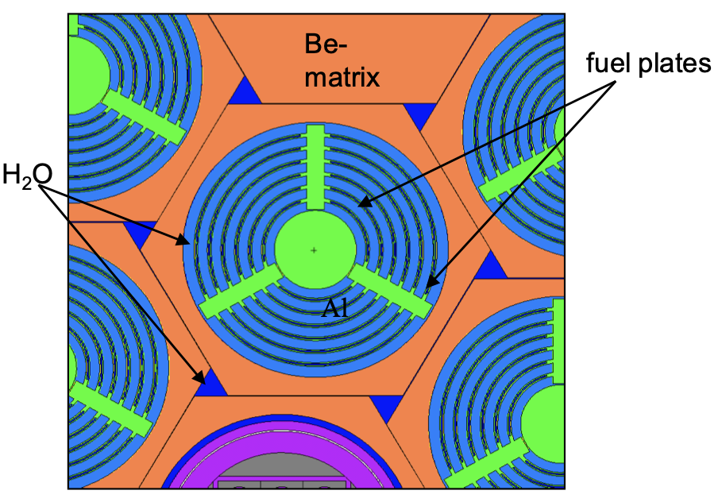
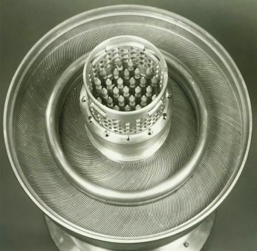
Fuel Assemblies
a) ATR
b) MITR
c) MURR
d) BR2
e) HFIR
b)
a)
d)
e)
c)

Slide 12
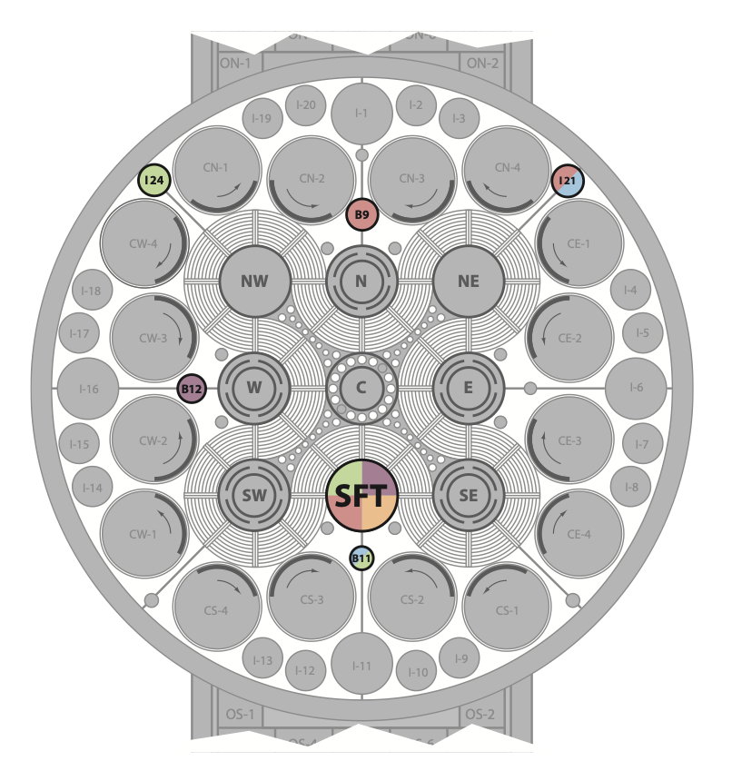
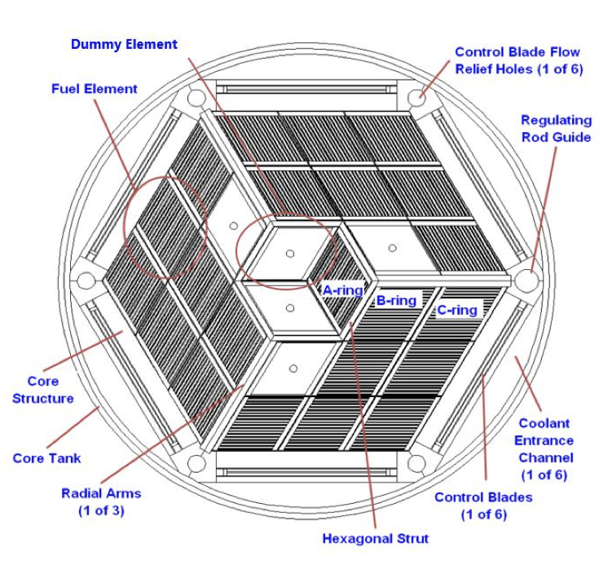
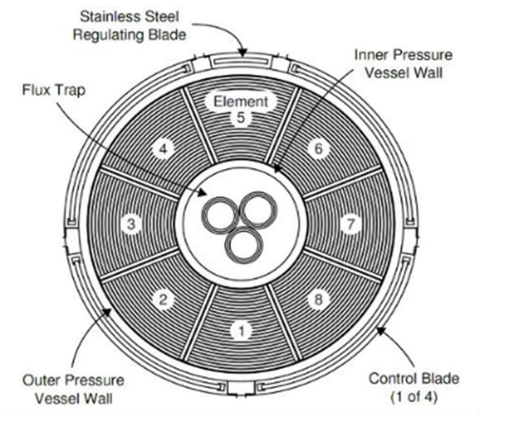
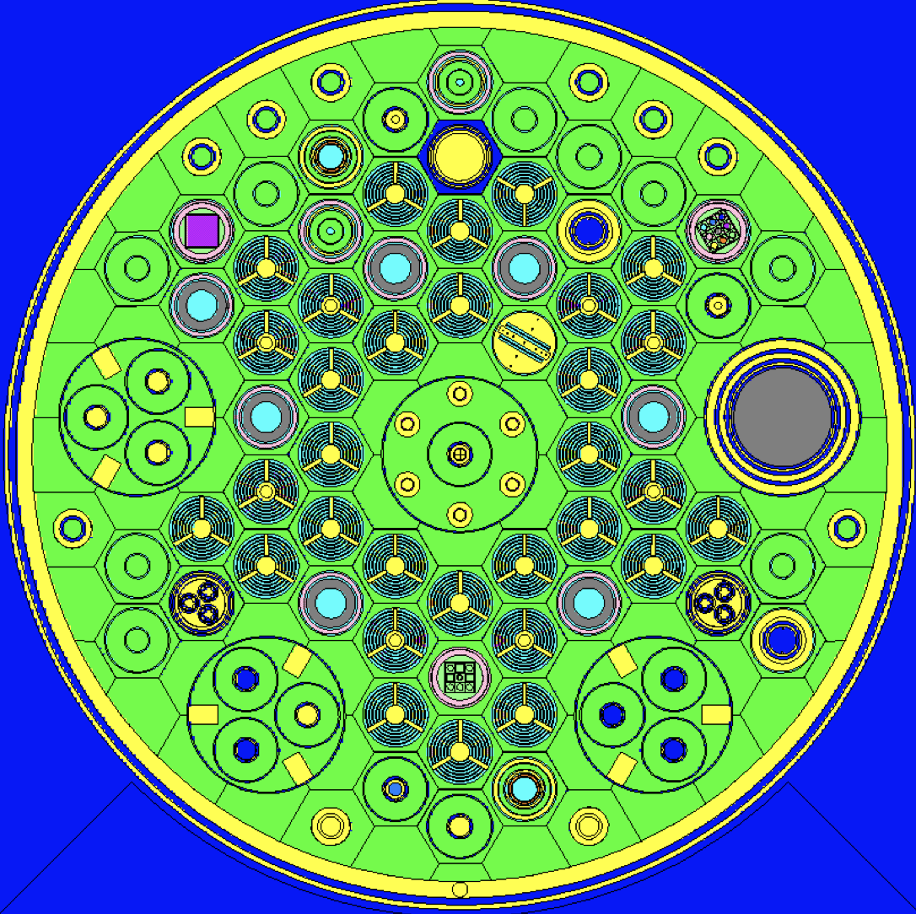
RTR Cores
b)
c)
a)
a) ATR
b) MITR
c) MURR
d) BR2
e) HFIR
d)
e)

Slide 13
RTR Design Overview
Mostly curved plates, with different curvatures and different thicknesses, different coolant channel widths
Flat plates for MITR
Designed with irradiation positions (flux traps) for:
materials testing
isotope production
Designs are all unique, trying to generate either single or multiple areas with concentrations of flux
Different reactors target different power densities and different levels of burnup
HFIR and ATR are very high power
NBSR is lower power but goes to very high fission density
JHR and BR2 in Europe are at moderate power, but very high fission density
Wide variety of conditions for both manufacturing and performance of fuels, all of which need to be covered for qualification

Slide 14
That’s it!
Some time for other stuff not on the exam

